Slide 1
DATA VISUALIZATION
BY: CANICRATES

Slide 2
TEAM CHARTER
’To fulfil the needs of our sponsor through a tangible project plan in a collaborative and positive team dynamic’.
TEAM LEAD - ABHISHEK KUMAR - represents team to sponsor, via email and on calls, to minimize communication errors.
PROJECT MANAGER - VIJAY VARSHINI LAKSHMI NARAYANAN - provides guidance and draws out insight from other team members, ensures that the project execution remains on track.
PROJECT SCRIBE - NIRALI HIRPARA - responsible to taking meeting minutes and distributing notes/assignments. Can assist Team Lead in drafting emails and communication between sponsor and group.
PROJECT LEAD - TAHIRA KANWAL, NARLA AKHILA - responsible for holding the group accountable for meeting deadlines and ensures that the project deliverables are being met.

Slide 3
Event: SuperHero U
Superhero U was an endeavor to empower imaginative and fervent young minds to make the best possible use of their skills and creativity.
Influenced by the UN's mission :-“to promote prosperity while protecting the planet”
Superhero U was a competitive event that was targeted towards providing an encouraging and equal educational opportunity to the budding stars.
The competitors joined ‘Superhero U’ as individuals or in teams.
‘Superhero U’ was conducted in three rounds –
Preliminary,
Semi-final
and Final

Slide 4
FACEBOOK AD
Facebook contains ads that help pay for the service. This allows businesses, such as GlobalShala, to pay for Facebook ad campaigns.
The data is collect in facebook ad of user who click any part of campaign tab.
Some of the terms like:-
Click
Unique click
Unique Link click
Click Through rate
Unique click through rate

Slide 5
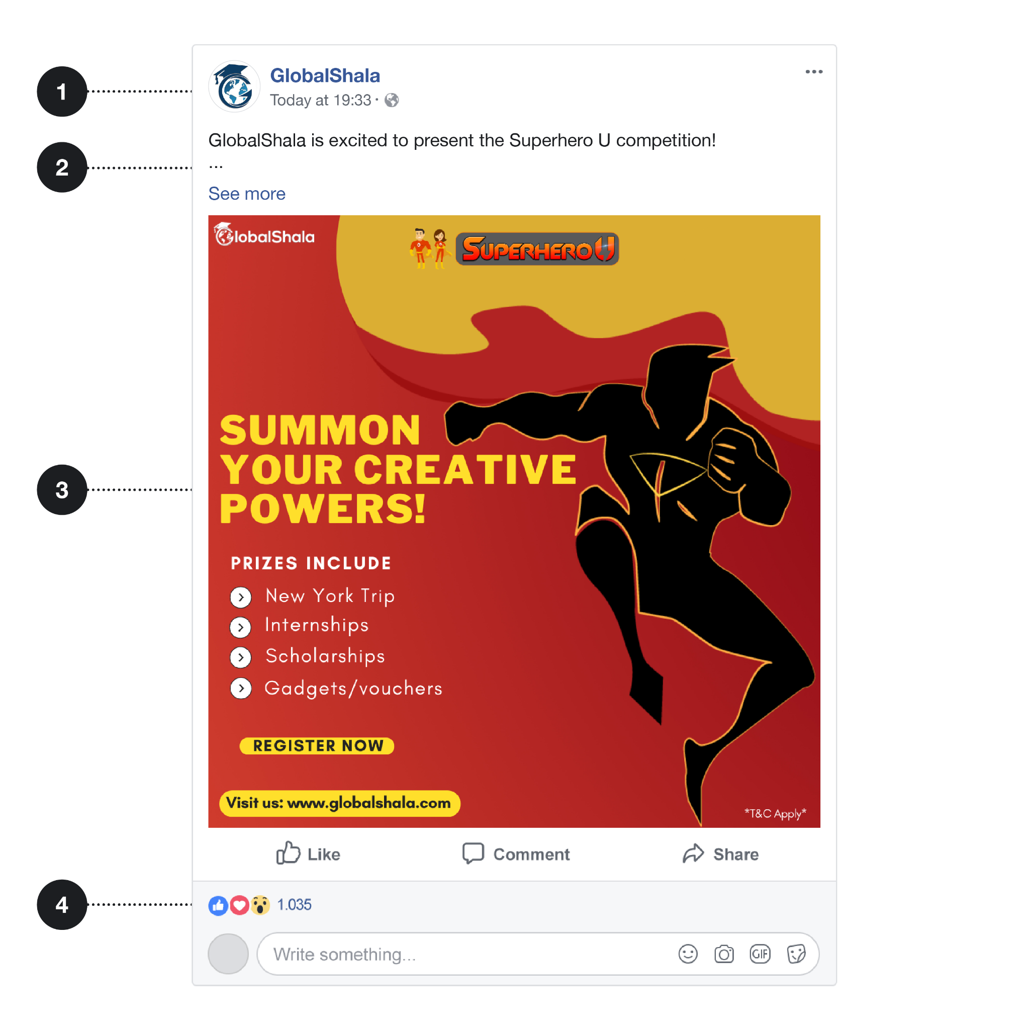
FACEBOOK AD LOOK LIKE
These ads have several parts:
A profile picture and profile name that links to GlobalShala’s profile page.
Some descriptive text.
An image that, in this case, links to the Superhero U website.
Buttons to like, comment, and share the ad.

Slide 6
OVERVIEW OF SUPERHERO U AD CAMPAIGN
Superhero U ad campaign was an endeavor to inspire students inventiveness and intensify their imagination to envision how to make the world a better place, Influenced by the UN’s mission “to promote prosperity while protecting the planet”.
Pre-college and college students were asked to invent a “superhero” capable of tackling one of the global social challenges outlined in the United Nations Sustainable Development Goals (SDGs) for 2030.
Individuals and groups employed descriptions, drawings, illustrations, animations, and multimedia presentations to bring their creations to life. Five key SDG themes emerged: peace, prosperity, people, planet, and partnerships. The superheroes were designed to cultivate a force of forward-thinking and social entrepreneurship.

Slide 7
CAMPAIGN ANALYSIS
We chose ‘Campaign 3’ as the campaign that needs to be discontinued because of two factors. They are:
Number of reach &
Cost per result
The number of reach for each individual age group is very less compared to the other campaign’s number of reaches.
The Cost per result for each individual group is high, when summed for many days could give an amount equal to an Audi Car.

Slide 8
Hence, the number of reach is not directionally proportional to the cost per result, which does not allow the ad page to encounter any profit, just like how a simple current is not directly proportional to its potential difference across them. If one increases, the other factor automatically decreases.
Users will not be interested in such scenarios and hence it is better to discontinue the particular ad campaign to save the event popularity and integrity.
The age group here acts as the independent variable and the number of reach and cost per result are the dependent variables which change according to the age groups.

Slide 9
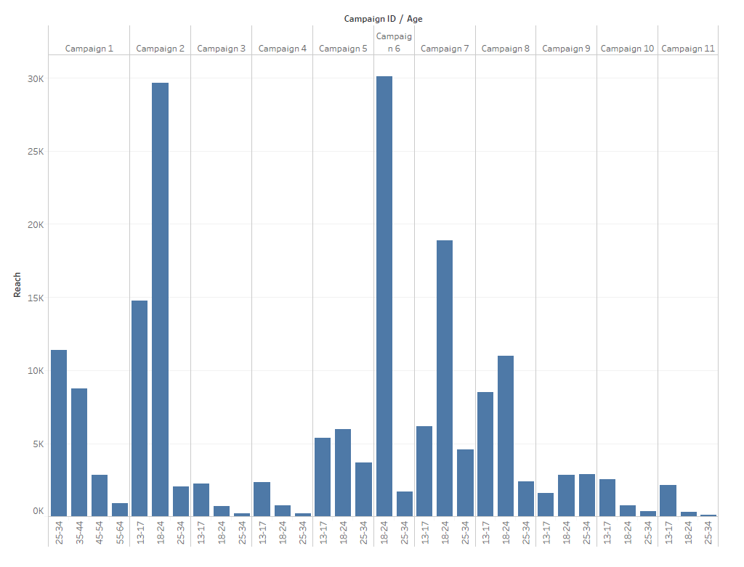

Slide 10
From the above graph, it is clearly stated that the reach for the age group of 25-34 is the lowest followed by the age group of 13-17 and then the age group of 18-24. They have secured the first three places of the prize possession just like runners in a marathon.

Slide 11
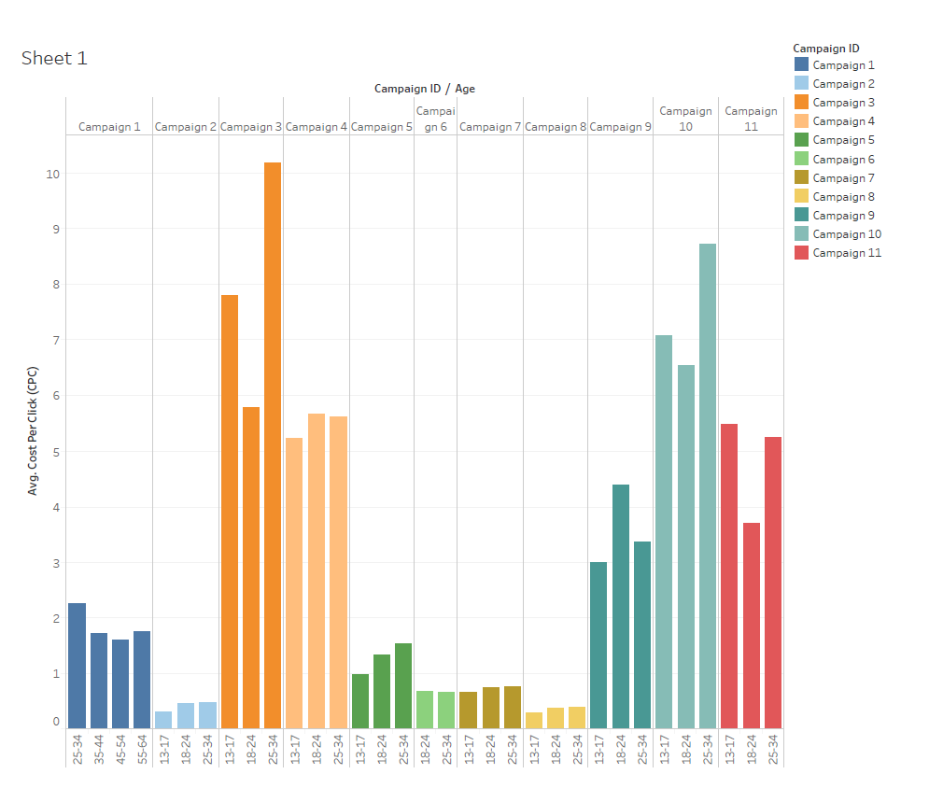

Slide 12
From the above graph, it is clearly stated that the reach for the age group of 25-34 is the highest followed by the age group of 13-17 and then the age group of 18-24. They have secured the first three places of the prize possession just like runners in a marathon from the order of highest to lowest.

Slide 13
CONCLUSION
Overall, Campaign 3 is chosen because it has minimum reach for all the 3 age groups with a simultaneous high value for cost per result.
This cost per result (CPR), cost per unique click (CPC) for each click is very expensive and moreover when this much is provided for an ad with less number of reach within a single country, then the company is not profited overall. Hence, it represents loss and has to be removed from the campaign.

